Slide 1


Module 5
Section of Solids
Sheba Varghese
Assistant Professor,
Dept. Of Mechanical Engineering,
Room : A (310), KJSCE, Vidyavihar
Email : sheba@somaiya.edu

Slide 2
Introduction
An object is assumed to be sectioned for completely exposing the interior hidden details.
The view thus obtained is known as SECTIONAL VIEW
The cut surface is called SECTION
The actual shape of the section is known as TRUE SHAPE OF THE SECTION.

Slide 3
Types of Sectional Views for Solids
Cutting plane is obtained by Horizontal Planes.
2. Cutting plane is obtained by Vertical Planes.
3. Cutting plane is obtained by Auxiliary Inclined Planes.
4. Cutting plane is obtained by Auxiliary Vertical Planes.
5. Cutting plane is obtained by Profile Planes.

Slide 4
Types of Section Planes
Vertical Section Plane
Horizontal Section Plane
Profile Section Plane
Auxiliary Section Plane
Oblique Section Plane

Slide 5
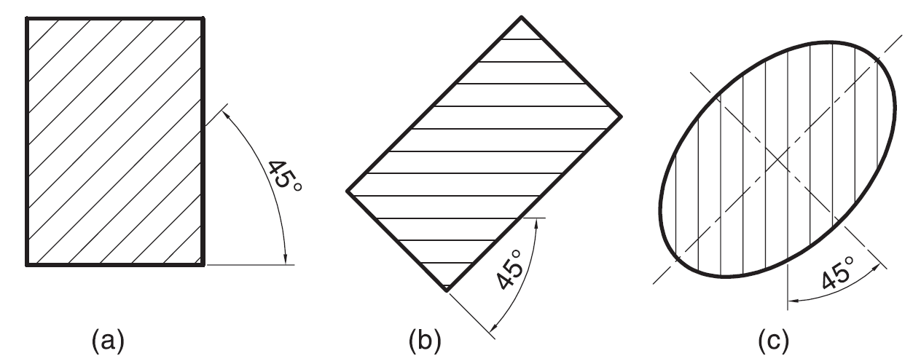
Hatching of the Sections
The surface created by cutting the object by a section plane is called as section.
The section is indicated by drawing the hatching lines (section lines) within the sectioned area.
The hatching lines are drawn at 45° to the principal outlines or the lines of symmetry of the section
The spacing between hatching lines should be uniform and in proportion to the size of the section.

Slide 6
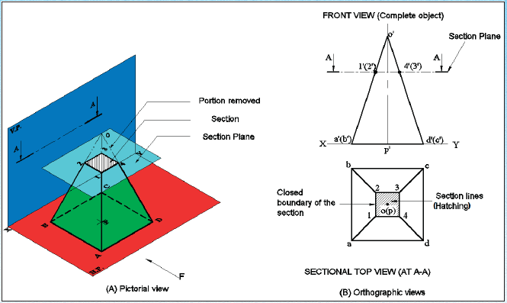
Section of Solids

Slide 7
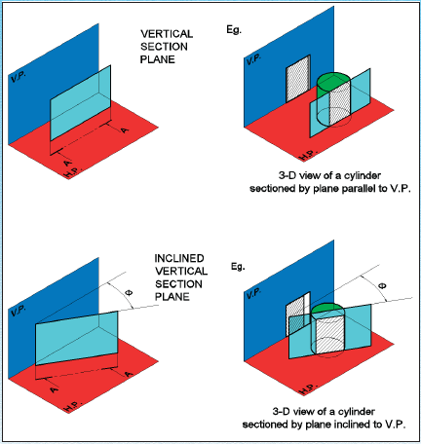
Vertical Section Plane

Slide 8
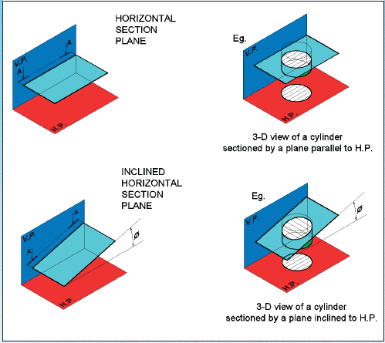
Horizontal Section Plane

Slide 9
Theory of Sectioning
Whenever a section plane cuts a solid, it intersects (and or coincides with) the edges of the solids.
The point at which the section plane intersects an edge of the solid is called the point of intersection (POI).
In case of the solids having a curved surface, viz., cylinder, cone and sphere, POIs are located between the cutting plane and the lateral lines.

Slide 10
True Shape of Section
A section will show its true shape when viewed in normal direction.
To find the true shape of a section, it must be projected on a plane parallel to the section plane.
For polyhedra, the true shape of the section depends on the number of POIs. The shape of the section will be a polygon of the sides equal to the number of POIs.
The true shape of the section of a sphere is always a circle.

Slide 11
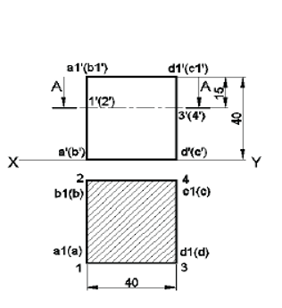
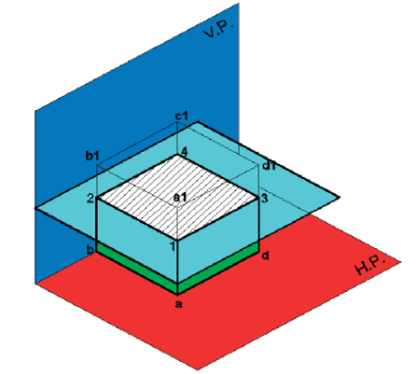
Example
SECTIONAL VIEW – PARALLEL TO H.P AND PERPENDICULAR TO V.P
A cube of 40 mm side is cut by a horizontal section plane, parallel to H.P at a distance of 15 mm from the top end. Draw the sectional top view and front view

Slide 12
True Shape of Section
The sections of prisms and pyramids are straight line segmented curves.
The sections of cylinders and cones will mostly have smooth curves.
Whenever a section plane cuts a solid, it intersects (and or coincides with) the edges of the solids.
The point at which the section plane intersects an edge of the solid is called the point of intersection (POI).
In case of the solids having a curved surface, viz., cylinder, cone and sphere, POIs are located between the cutting plane and the lateral lines.

Slide 13
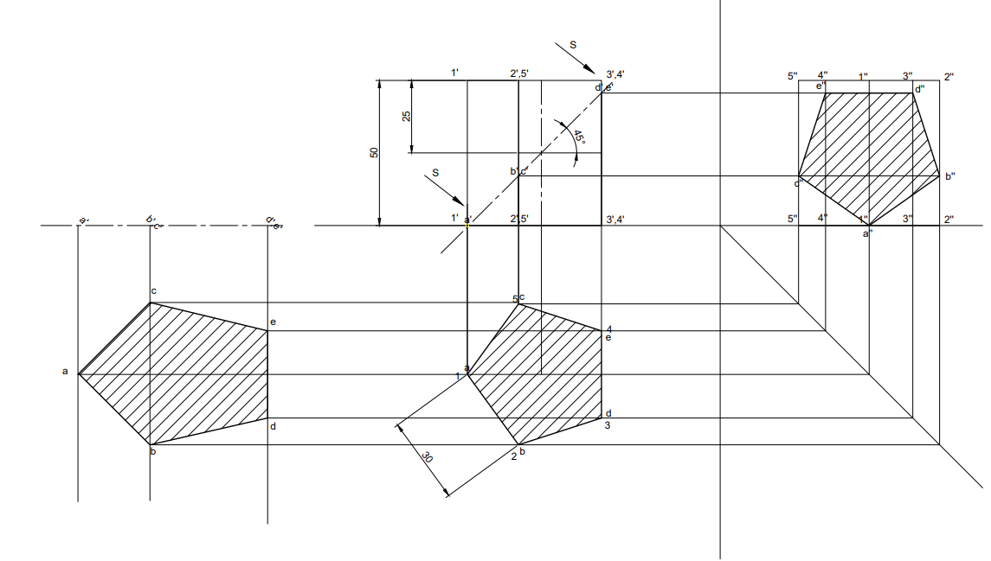
True Shape of Section
A pentagonal prism , 30 mm base side & 50 mm axis is standing on Hp on it’s base whose one side is perpendicular to V.P. It is cut by a section plane 45⁰ inclined to H.P, through mid point of axis. Draw F.V, Sectional T.V & Sectional Side view. Also draw true shape of section

Slide 14
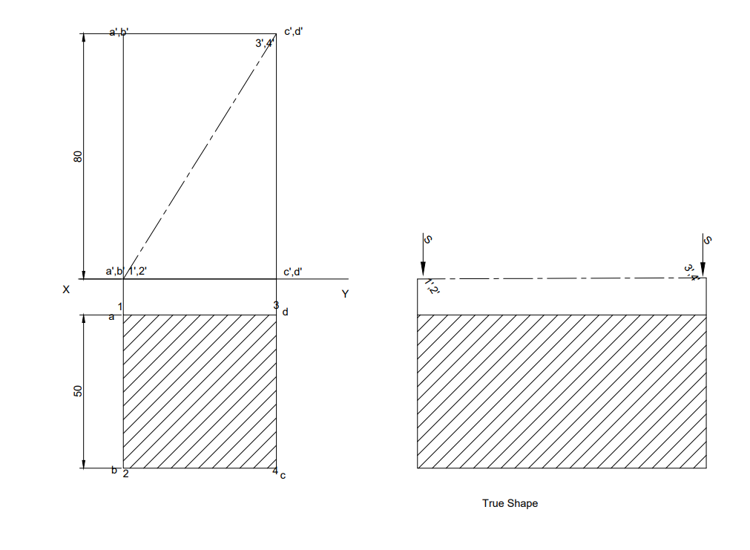
A square prism of base side 50 mm and height of axis 80 mm has its base on H.P, it is cut by a section plane perpendicular to V.P and inclined to H.P such that it passes through the two opposite corners of the rectangular face in front. Draw the sectional Top View and Front View and true shape of the section

Slide 15
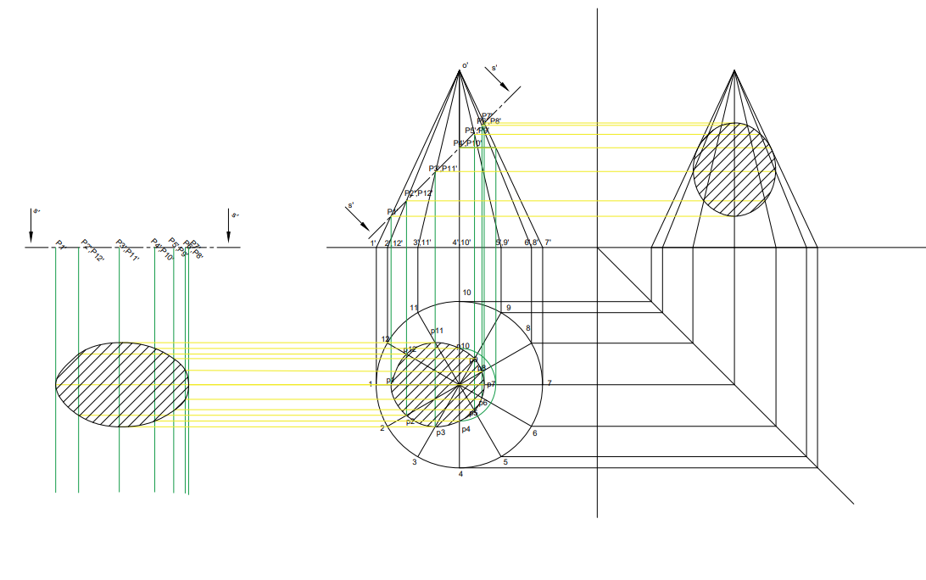
A Cone base 75 mm diameter and axis 80 mm long is resting on its base on H.P. It is cut by a section plane perpendicular to the V.P., inclined at 45º to the H.P. and cutting the axis at a point 35 mm from the apex. Draw the front view, sectional top view, sectional side view and true shape of the section.

Slide 16
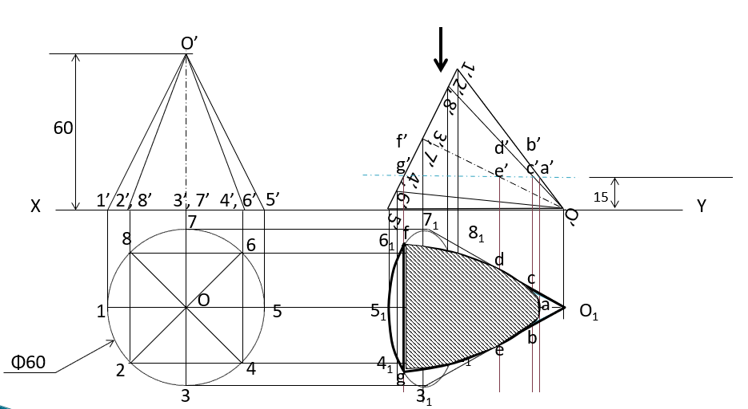
A cone of diameter 60 mm and height 60 mm is resting on HP on one of its generators. A section plane whose VT is parallel to HP and 15 mm above HP, cuts the solid removing the top portion. Draw the front view and sectional top view of the solid.

Slide 17
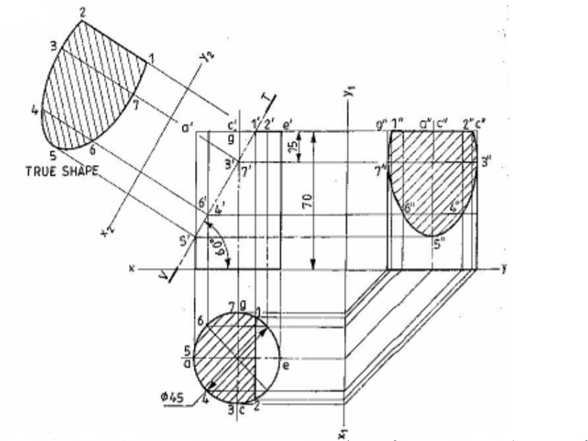
A cylinder of 45 mm diameter and 70 mm long, is resting on one of its bases on H.P. It is cut by a section plane, inclined at 60̊ with H.P and passing through a point on the axis at 15 mm from one end. Draw the three views of the solid and also obtain the true shape of the section .

Slide 18
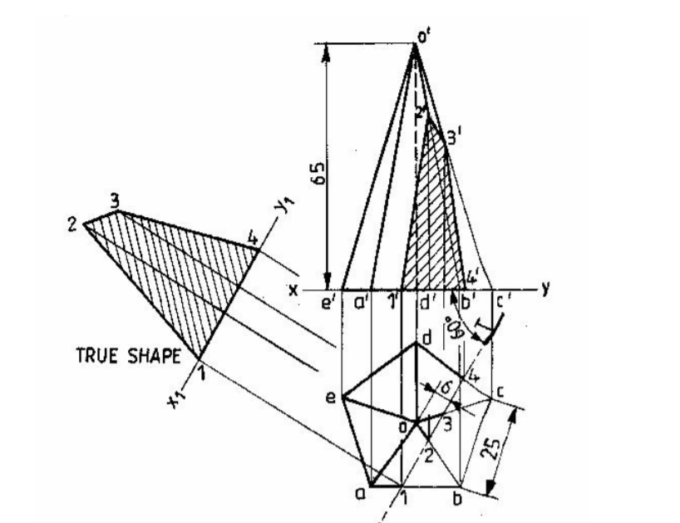
A pentagonal pyramid with edge of base 25 mm and axis 65 mm long, is resting on H.P on its base with an edge nearer to the observer, parallel to V.P. It is cut by a section plane, inclined at 60̊ to V.P and at a distance of 6 mm from the axis. Draw the projections and obtain the true shape of the section.

Slide 19
